Slide 1
Transform and Conquer
This group of techniques solves a problem by a transformation to
a simpler/more convenient instance of the same problem (instance simplification)
a different representation of the same instance (representation change)
a different problem for which an algorithm is already available (problem reduction)

Slide 2
Instance simplification - Presorting
Solve a problem’s instance by transforming it into
another simpler/easier instance of the same problem
Presorting
Many problems involving lists are easier when list is sorted, e.g.
searching
computing the median (selection problem)
checking if all elements are distinct (element uniqueness)
Also:
Topological sorting helps solving some problems for dags.
Presorting is used in many geometric algorithms.

Slide 3
How fast can we sort ?
Efficiency of algorithms involving sorting depends on
efficiency of sorting.
Theorem (see Sec. 11.2): ⎡log₂ n!⎤ ≈ n log₂ n comparisons are necessary in the worst case to sort a list of size n by any comparison-based algorithm.
Note: About nlog₂ n comparisons are also sufficient to sort array of size n (by mergesort).

Slide 4
Searching with presorting
Problem: Search for a given K in A[0..n-1]
Presorting-based algorithm:
Stage 1 Sort the array by an efficient sorting algorithm
Stage 2 Apply binary search
Efficiency: Θ(nlog n) + O(log n) = Θ(nlog n)
Good or bad?
Why do we have our dictionaries, telephone directories, etc. sorted?

Slide 5
Element Uniqueness with presorting
Presorting-based algorithm
  Stage 1: sort by efficient sorting algorithm (e.g. mergesort)
  Stage 2: scan array to check pairs of adjacent elements
  Efficiency: Θ(nlog n) + O(n) = Θ(nlog n)
Brute force algorithm
Compare all pairs of elements
Efficiency: O(n²)
Another algorithm? Hashing

Slide 6
Instance simplification – Gaussian Elimination
Given: A system of n linear equations in n unknowns with an arbitrary coefficient matrix.
Transform to: An equivalent system of n linear equations in n unknowns with an upper triangular coefficient matrix.
Solve the latter by substitutions starting with the last equation and moving up to the first one.
a₁₁x₁ + a₁₂x₂ + … + a_{1n}x_{n} = b₁ a_{1,1}x₁+ a₁₂x₂ + … + a_{1n}x_{n} = b₁
a₂₁x₁ + a₂₂x₂ + … + a_{2n}x_{n} = b₂ a₂₂x₂ + … + a_{2n}x_{n} = b₂
a_{n1}x₁ + a_{n2}x₂ + … + a_{nn}x_{n} = b_{n} a_{nn}x_{n} = b_{n}

Slide 7
Gaussian Elimination (cont.)
The transformation is accomplished by a sequence of elementary operations on the system’s coefficient matrix (which don’t change the system’s solution):
for i ←1 to n-1 do
replace each of the subsequent rows (i.e., rows i+1, …, n) by
a difference between that row and an appropriate multiple
of the i-th row to make the new coefficient in the i-th column
of that row 0

Slide 8
Example of Gaussian Elimination
Solve 2x₁ - 4x₂ + x₃ = 6
3x₁ - x₂ + x₃ = 11
x₁ + x₂ - x₃ = -3
Gaussian elimination
2 -4 1 6 2 -4 1 6
3 -1 1 11 row2 – (3/2)*row1 0 5 -1/2 2
1 1 -1 -3 row3 – (1/2)*row1 0 3 -3/2 -6 row3–(3/5)*row2
2 -4 1 6
0 5 -1/2 2
0 0 -6/5 -36/5
Backward substitution
x₃ = (-36/5) / (-6/5) = 6
x₂ = (2+(1/2)*6) / 5 = 1
x₁ = (6 – 6 + 4*1)/2 = 2

Slide 9
Pseudocode and Efficiency of Gaussian Elimination
Stage 1: Reduction to an upper-triangular matrix
for i ← 1 to n-1 do
for j ← i+1 to n do
for k ← i to n+1 do
A[j, k] ← A[j, k] - A[i, k] * A[j, i] / A[i, i] //improve!
Stage 2: Back substitutions
for j ← n downto 1 do
t ← 0
for k ← j +1 to n do
t ← t + A[j, k] * x[k]
x[j] ← (A[j, n+1] - t) / A[j, j]
Efficiency: Θ(n³) + Θ(n²) = Θ(n³)

Slide 10
Searching Problem
Problem: Given a (multi)set S of keys and a search
key K, find an occurrence of K in S, if any
Searching must be considered in the context of:
  file size (internal vs. external)
  dynamics of data (static vs. dynamic)
Dictionary operations (dynamic data):
  find (search)
  insert
  delete

Slide 11
Taxonomy of Searching Algorithms
List searching
  sequential search
  binary search
  interpolation search
Tree searching
  binary search tree
  binary balanced trees: AVL trees, red-black trees
  multiway balanced trees: 2-3 trees, 2-3-4 trees, B trees
Hashing
  open hashing (separate chaining)
  closed hashing (open addressing)

Slide 12
Binary Search Tree
Arrange keys in a binary tree with the binary search tree property:
K
<K
>K
Example: 5, 3, 1, 10, 12, 7, 9

Slide 13
Dictionary Operations on Binary Search Trees
  Searching – straightforward
  Insertion – search for key, insert at leaf where search terminated
  Deletion – 3 cases:
    deleting key at a leaf
    deleting key at node with single child
    deleting key at node with two children
Efficiency depends of the tree’s height: ⎣log₂ n⎦ ≤ h ≤ n-1,
with height average (random files) be about 3log₂ n
Thus all three operations have
  worst case efficiency: Θ(n)
  average case efficiency: Θ(log n)
Bonus: inorder traversal produces sorted list
Notes:
1.41 lg n = 2 ln n

Slide 14
Balanced Search Trees
Attractiveness of binary search tree is marred by the bad (linear) worst-case efficiency. Two ideas to overcome it are:
to rebalance binary search tree when a new insertion
makes the tree “too unbalanced”
  AVL trees
  red-black trees
to allow more than one key per node of a search tree
  2-3 trees
  2-3-4 trees
  B-trees

Slide 15
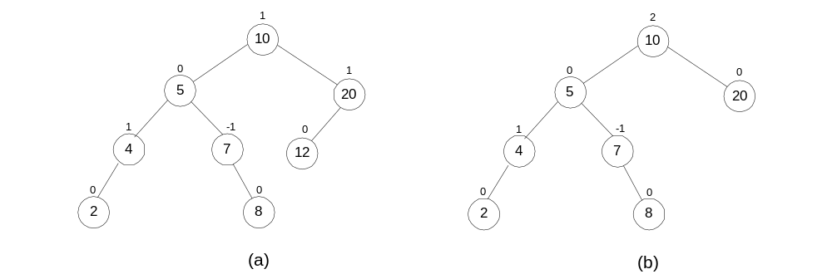
Balanced trees: AVL trees
Definition An AVL tree is a binary search tree in which, for every node, the difference between the heights of its left and right subtrees, called the balance factor, is at most 1 (with the height of an empty tree defined as -1)
Tree (a) is an AVL tree; tree (b) is not an AVL tree

Slide 16
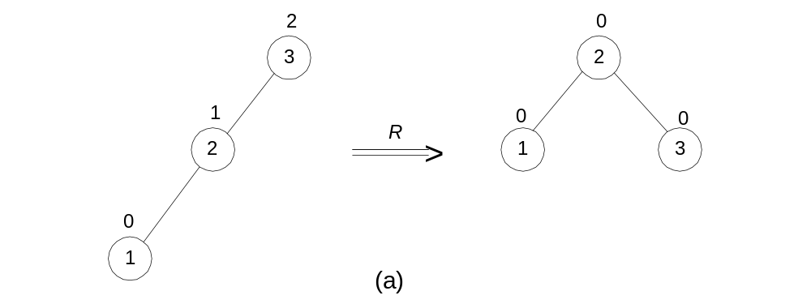
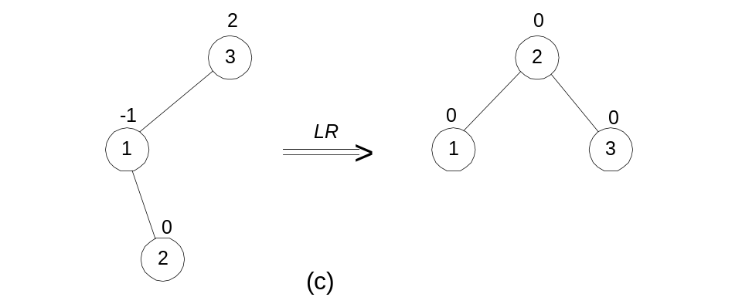
Rotations
If a key insertion violates the balance requirement at some node, the subtree rooted at that node is transformed via one of the four rotations. (The rotation is always performed for a subtree rooted at an “unbalanced” node closest to the new leaf.)
Single R-rotation
Double LR-rotation

Slide 17
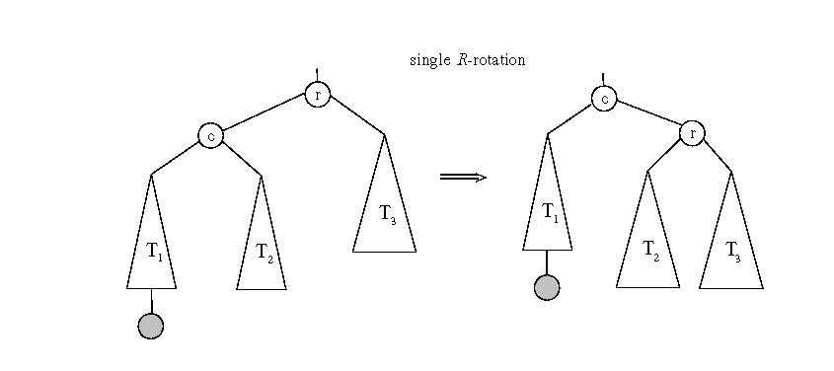
General case: Single R-rotation

Slide 18
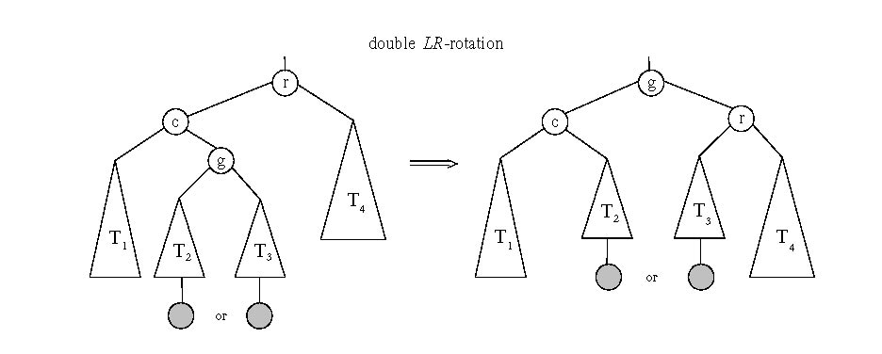
General case: Double LR-rotation

Slide 19
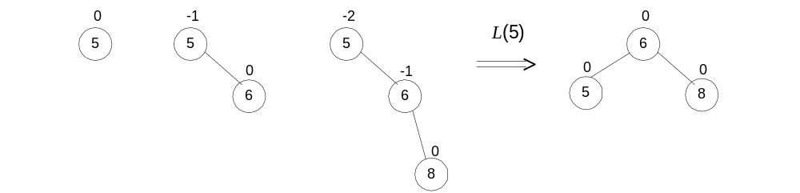
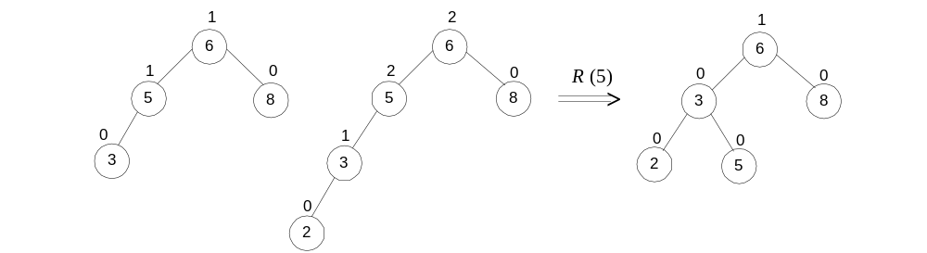
AVL tree construction - an example
Construct an AVL tree for the list 5, 6, 8, 3, 2, 4, 7

Slide 20
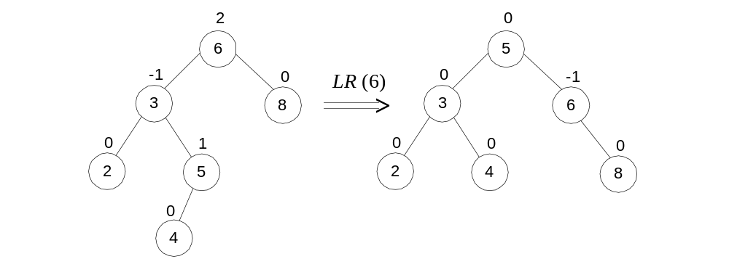
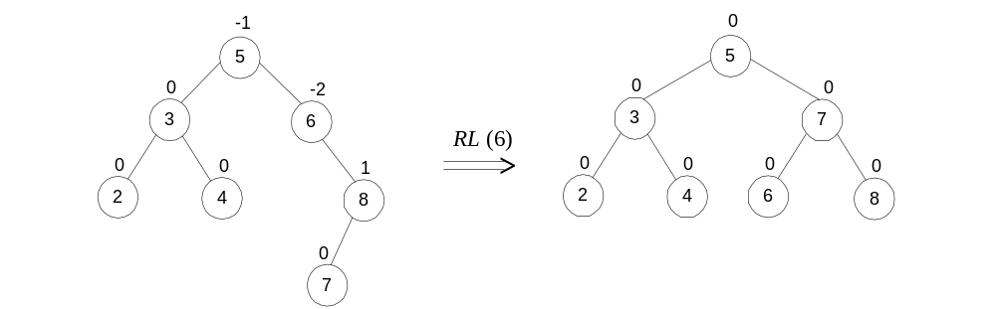
AVL tree construction - an example (cont.)

Slide 21
Analysis of AVL trees
h ≤ 1.4404 log₂ (n + 2) - 1.3277
average height: 1.01 log₂n + 0.1 for large n (found empirically)
Search and insertion are O(log n)
Deletion is more complicated but is also O(log n)
Disadvantages:
  frequent rotations
  complexity
A similar idea: red-black trees (height of subtrees is allowed to differ by up to a factor of 2)

Slide 22
Multiway Search Trees
Definition A multiway search tree is a search tree that allows
more than one key in the same node of the tree.
Definition A node of a search tree is called an n-node if it contains n-1 ordered keys (which divide the entire key range into n intervals pointed to by the node’s n links to its children):
Note: Every node in a classical binary search tree is a 2-node
k₁ < k₂ < … < k_{n-1}
< k₁
[k₁, k₂ )
≥ k_{n-1}

Slide 23
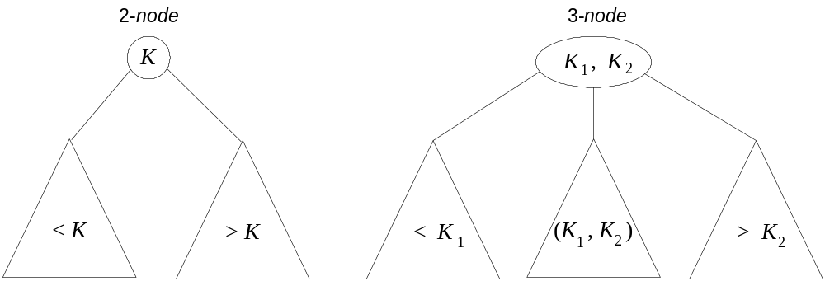
2-3 Tree
Definition A 2-3 tree is a search tree that
may have 2-nodes and 3-nodes
height-balanced (all leaves are on the same level)
A 2-3 tree is constructed by successive insertions of keys given, with a new key always inserted into a leaf of the tree. If the leaf is a 3-node, it’s split into two with the middle key promoted to the parent.

Slide 24
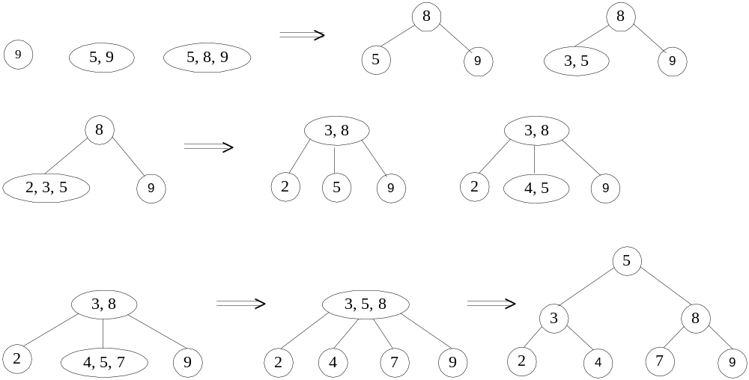
2-3 tree construction – an example
Construct a 2-3 tree the list 9, 5, 8, 3, 2, 4, 7

Slide 25
Analysis of 2-3 trees
log₃ (n + 1) - 1 ≤ h ≤ log₂ (n + 1) - 1
Search, insertion, and deletion are in Θ(log n)
The idea of 2-3 tree can be generalized by allowing more keys per node
  2-3-4 trees
  B-trees

Slide 26
Heaps and Heapsort
Definition A heap is a binary tree with keys at its nodes (one key per node) such that:
It is essentially complete, i.e., all its levels are full except possibly the last level, where only some rightmost keys may be missing
The key at each node is ≥ keys at its children

Slide 27
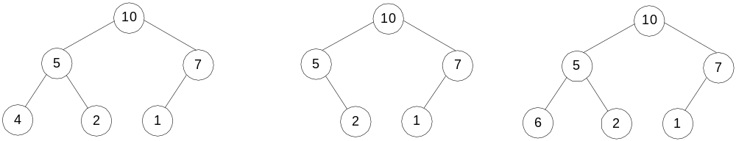
Illustration of the heap’s definition
a heap
not a heap
not a heap
Note: Heap’s elements are ordered top down (along any path
down from its root), but they are not ordered left to right

Slide 28
Some Important Properties of a Heap
Given n, there exists a unique binary tree with n nodes that
is essentially complete, with h = ⎣log₂ n⎦
The root contains the largest key
The subtree rooted at any node of a heap is also a heap
A heap can be represented as an array

Slide 29
Heap’s Array Representation
Store heap’s elements in an array (whose elements indexed, for convenience, 1 to n) in top-down left-to-right order
Example:
Left child of node j is at 2j
Right child of node j is at 2j+1
Parent of node j is at ⎣j/2⎦
Parental nodes are represented in the first ⎣n/2⎦ locations
9
1 2 3 4 5 6
5
3
9 5 3 1 4 2
1
4
2

Slide 30
Heap Construction (bottom-up)
Step 0: Initialize the structure with keys in the order given
Step 1: Starting with the last (rightmost) parental node, fix the heap rooted at it, if it doesn’t satisfy the heap condition: keep exchanging it with its largest child until the heap condition holds
Step 2: Repeat Step 1 for the preceding parental node

Slide 31
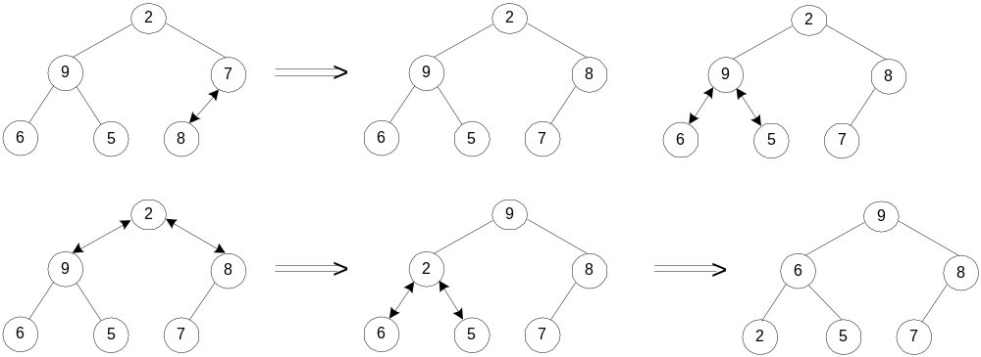
Example of Heap Construction
Construct a heap for the list 2, 9, 7, 6, 5, 8

Slide 32
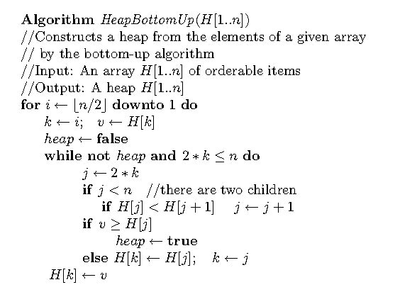
Pseudopodia of bottom-up heap construction

Slide 33
Heapsort
Stage 1: Construct a heap for a given list of n keys
Stage 2: Repeat operation of root removal n-1 times:
    Exchange keys in the root and in the last (rightmost) leaf
    Decrease heap size by 1
    If necessary, swap new root with larger child until the heap condition holds

Slide 34
Example of Sorting by Heapsort
Sort the list 2, 9, 7, 6, 5, 8 by heapsort
Stage 1 (heap construction) Stage 2 (root/max removal)
1 9 7 6 5 8 9 6 8 2 5 7
2 9 8 6 5 7 7 6 8 2 5 | 9
2 9 8 6 5 7 8 6 7 2 5 | 9
9 2 8 6 5 7 5 6 7 2 | 8 9
9 6 8 2 5 7 7 6 5 2 | 8 9
2 6 5 | 7 8 9
6 2 5 | 7 8 9
5 2 | 6 7 8 9
5 2 | 6 7 8 9
2 | 5 6 7 8 9

Slide 35
Analysis of Heapsort
Stage 1: Build heap for a given list of n keys
worst-case
C(n) =
Stage 2: Repeat operation of root removal n-1 times (fix heap)
worst-case
C(n) =
Both worst-case and average-case efficiency: Θ(nlogn)
In-place: yes
Stability: no (e.g., 1 1)
h-1
Σ
2(h-i) 2^{i} = 2 ( n – log₂(n + 1)) ∈ Θ(n)
i=0
# nodes at level i
n-1
Σ
2log₂ i ∈ Θ(nlogn)
i=1

Slide 36
Priority Queue
A priority queue is the ADT of a set of elements with
numerical priorities with the following operations:
  find element with highest priority
  delete element with highest priority
  insert element with assigned priority (see below)
Heap is a very efficient way for implementing priority queues
Two ways to handle priority queue in which
highest priority = smallest number

Slide 37
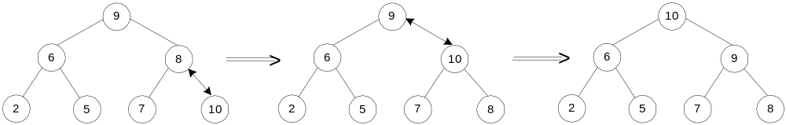
Insertion of a New Element into a Heap
Insert the new element at last position in heap.
Compare it with its parent and, if it violates heap condition,
exchange them
Continue comparing the new element with nodes up the tree until the heap condition is satisfied
Example: Insert key 10
Efficiency: O(log n)

Slide 38
Horner’s Rule For Polynomial Evaluation
Given a polynomial of degree n
p(x) = a_{n}x^{n} + a_{n-1}x^{n-1} + … + a₁x + a₀
and a specific value of x, find the value of p at that point.
Two brute-force algorithms:
p ← 0 p ← a₀; power ← 1
for i ← n downto 0 do for i ← 1 to n do
power ← 1 power ← power * x
for j ← 1 to i do p ← p + a_{i} * power
power ← power * x return p
p ← p + a_{i} * power
return p

Slide 39
Horner’s Rule
Example: p(x) = 2x⁴ - x³ + 3x² + x - 5 =
= x(2x³ - x² + 3x + 1) - 5 =
= x(x(2x² - x + 3) + 1) - 5 =
= x(x(x(2x - 1) + 3) + 1) - 5
Substitution into the last formula leads to a faster algorithm
Same sequence of computations are obtained by simply
arranging the coefficient in a table and proceeding as follows:
coefficients 2 -1 3 1 -5
x=3

Slide 40
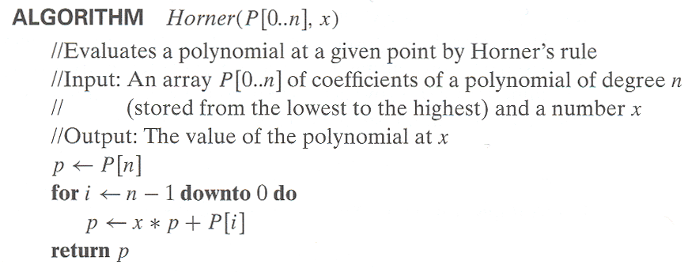
Horner’s Rule pseudocode
Efficiency of Horner’s Rule: # multiplications = # additions = n
Synthetic division of of p(x) by (x-x₀)
Example: Let p(x) = 2x⁴ - x³ + 3x² + x - 5. Find p(x):(x-3)

Slide 41
Computing a^{n} (revisited)
Left-to-right binary exponentiation
Initialize product accumulator by 1.
Scan n’s binary expansion from left to right and do the following:
If the current binary digit is 0, square the accumulator (S);
if the binary digit is 1, square the accumulator and multiply it by a (SM).
Example: Compute a¹³. Here, n = 13 = 1101₂
binary rep. of 13: 1 1 0 1
SM SM S SM
accumulator: 1 1²*a=a a²*a = a³ (a³)² = a⁶ (a⁶)²*a= a¹³ (computed left-to-right)
Efficiency: b ≤ M(n) ≤ 2b where b = ⎣log₂ n⎦ + 1

Slide 42
Computing a^{n} (cont.)
Right-to-left binary exponentiation
Scan n’s binary expansion from right to left and compute a^{n} as the product of terms a^{2 i} corresponding to 1’s in this expansion.
Example Compute a¹³ by the right-to-left binary exponentiation. Here, n = 13 = 1101₂.
1 1 0 1
a⁸ a⁴ a² a : a^{2 i} terms
a⁸ * a⁴ * a : product (computed right-to-left)
Efficiency: same as that of left-to-right binary exponentiation

Slide 43
Problem Reduction
This variation of transform-and-conquer solves a problem by a transforming it into different problem for which an algorithm is already available.
To be of practical value, the combined time of the transformation and solving the other problem should be smaller than solving the problem as given by another method.

Slide 44
Examples of Solving Problems by Reduction
computing lcm(m, n) via computing gcd(m, n)
counting number of paths of length n in a graph by raising the graph’s adjacency matrix to the n-th power
transforming a maximization problem to a minimization problem and vice versa (also, min-heap construction)
linear programming
reduction to graph problems (e.g., solving puzzles via state-space graphs)

